Slide 1
Web Crawling – Abstract Analysis
0856706 Susan Ku

Slide 2
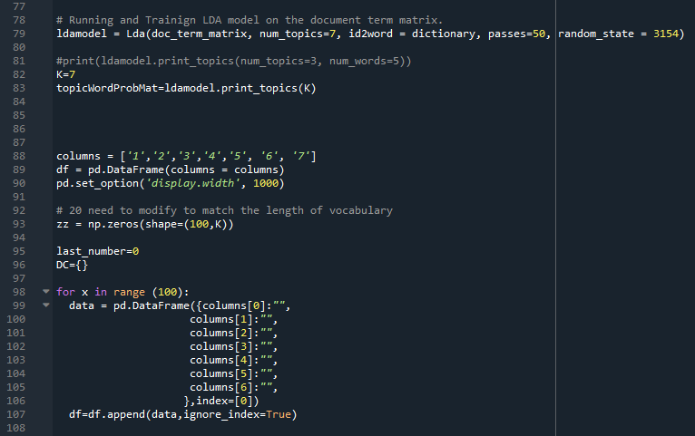
Briefing of Implementation
Select K=7, followings are modifications in code

Slide 3

Result: heat map
#4
Approach for Currency market
market
crix
model
option
cryptocurrency
trading
convergence
sentiment
variable
return
distribution
portfolio
value
currency
energy
tail
price
#1
Crix model for Cryptos trading market
#5
Effect of research on market
price
test
jump
inequality
nonparametric
response
risk
method
data
regression
network
systemic
curve
analysis
#6
Asset analysis
volatility
time
rate
break
high
series
parameter
asset
approach
based
#7
Research on market forecast
#2
Risk analysis method
#3
Sentiment analysis for Economics
based
factor
research
forecast

